Slide 1
Genetic Algorithms

Slide 2
Evolutionary Algorithms
“Evolutionary Computing” was introduced in the 1960s by I. Rechenberg.
EA is a generic population based meta-heuristic optimization algorithm
An EA uses some mechanisms inspired by biological evolution: reproduction, mutation, recombination, and selection.
Candidate solutions to the optimization problem play the role of individuals in a population, and the fitness function determines the environment within which the solutions "live"
Evolution of the population then takes place after the repeated application of the above operators.
Various EA Techniques
    Genetic Algorithms
    Genetic Programming

Slide 3
History of Genetic Algorithms
Professor John Holland at the University of Michigan came up with book "Adaptation in Natural and Artificial Systems" explored the concept of using mathematically-based artificial evolution as a method to conduct a structured search for solutions to complex problems.
Dr. David E. Goldberg. In his 1989 landmark text "Genetic Algorithms in Search, Optimization and Machine Learning”, suggested applications for genetic algorithms in a wide range of engineering fields.

Slide 4
What Are Genetic Algorithms (GAs)?
Genetic Algorithms are search and optimization techniques based on Darwin’s Principle of Natural Selection.
“problems are solved by an evolutionary process resulting in a best (fittest) solution (survivor) ,
-In Other words, the solution is evolved”
1. Inheritance – Offspring acquire characteristics
2. Mutation – Change, to avoid similarity
3. Natural Selection – Variations improve survival
4. Recombination - Crossover

Slide 5
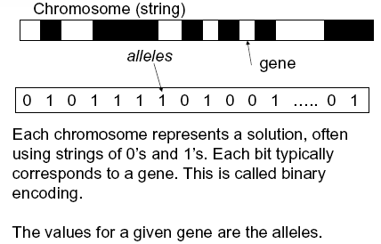
Genetics
Chromosome
All Living organisms consists of cells. In each cell there is a same set of Chromosomes.
Chromosomes are strings of DNA and consists of genes, blocks of DNA.
Each gene encodes a trait, for example color of eyes.
Reproduction
During reproduction, recombination (or crossover) occurs first. Genes from parents combine to form a whole new chromosome. The newly created offspring can then be mutated. The changes are mainly caused by errors in copying genes from parents.
The fitness of an organism is measure by success of the organism in its life (survival)

Slide 6
Principle Of Natural Selection
“Select The Best, Discard The Rest”
Two important elements required for any problem before a genetic algorithm can be used for a solution are:
Method for representing a solution (encoding)
ex: string of bits, numbers, character
Method for measuring the quality of any proposed solution, using fitness function
ex: Determining total weight

Slide 7
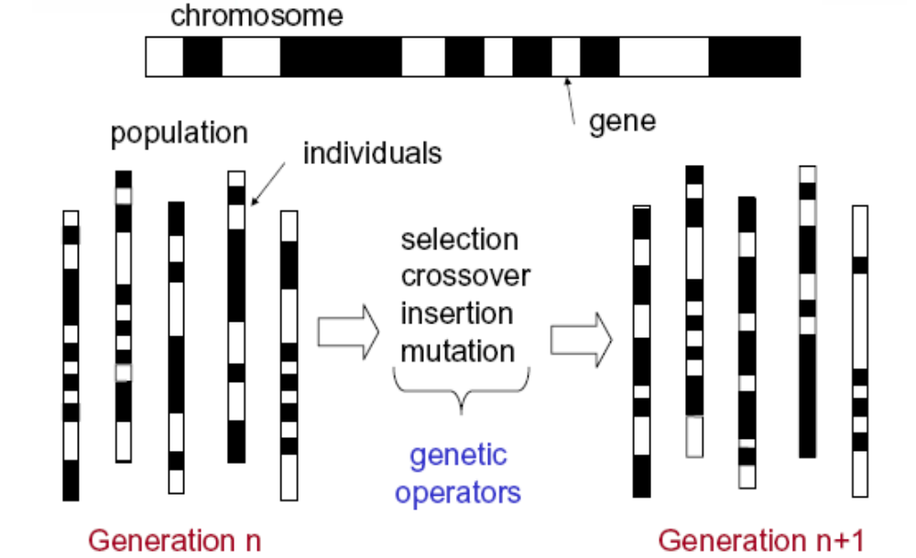
GA Elements

Slide 8
Search Space
If we are solving some problem, we are usually looking for some solution, which will be the best among others. The space of all feasible solutions (it means objects among those the desired solution is) is called search space (also state space). Each point in the search space represent one feasible solution. Each feasible solution can be "marked" by its value or fitness for the problem.
Initialization
Initially many individual solutions are randomly generated to form an initial population, covering the entire range of possible solutions (the search space)
Each point in the search space represents one possible solution marked by its value( fitness)
Selection
A proportion of the existing population is selected to bread a new bread of generation.
Reproduction
Generate a second generation population of solutions from those selected through genetic operators: crossover and mutation.
Termination
A solution is found that satisfies minimum criteria
Fixed number of generations found
Allocated budget (computation, time/money) reached
The highest ranking solution’s fitness is reaching or has reached

Slide 9
Methodology Associated with GAs
Begin
Initialize population
Evaluate Solutions
T =0 (first step)
Met Termination condition?
N
Selection
Y
T=T+1
(go to next step)
Stop
Crossover
Mutation

Slide 10
Creating a GA on Computer
Simple_Genetic_Algorithm()
{
Initialize the Population;
Calculate Fitness Function;
While (not termination condition)
{
Selection;//Natural Selection, Survival Of Fittest Crossover;//Reproduction, Propagate favorable characteristics
Mutation;
Calculate Fitness Function;
}
}

Slide 11
Representation
Phenotype space
Genotype space = {0,1}^{L}
Encoding
(representation)
10010001
10010010
010001001
011101001
Decoding
(inverse representation)

Slide 12
Encoding
The process of representing the solution in the form of a string that conveys the necessary information.
Just as in a chromosome, each gene controls a particular characteristic of the individual, similarly, each element in the string represents a characteristic of the solution.

Slide 13
Encoding Issue
How to encode a solution of the problem into a chromosome is a key issue for
genetic algorithms.
  In Holland's work, encoding is carried out using binary strings.
  For many GA applications, especially for the problems from industrial engineering world, the simple GA was difficult to apply directly as the binary string is not a natural coding.
During last ten years, various non-string encoding techniques have been created for particular problems. For example:
  The real number coding for constrained optimization problems
  The integer coding for combinatorial optimization problems.
Choosing an appropriate representation of candidate solutions to the problem at hand is the foundation for applying genetic algorithms to solve real world problems, which conditions all the subsequent steps of genetic algorithms.
For any application case, it is necessary to analysis carefully to result in an appropriate representation of solutions together with meaningful and problem-specific genetic operators.

Slide 14
Examples
Binary Encoding – Most common method of encoding. Chromosomes are strings of 1s and 0s and each position in the chromosome represents a particular characteristic of the problem.
Permutation Encoding – Useful in ordering problems such as the Traveling Salesman Problem (TSP). Example. In TSP, every chromosome is a string of numbers, each of which represents a city to be visited.
Value Encoding – Used in problems where complicated values, such as real numbers, are used and where binary encoding would not suffice.
Good for some problems, but often necessary to develop some specific crossover and mutation techniques for these chromosomes.
Chromosome A
10110010110011100101
Chromosome B
11111110000000011111
Chromosome A
1 5 3 2 6 4 7 9 8
Chromosome B
8 5 6 7 2 3 1 4 9
Chromosome A
1.235 5.323 0.454 2.321 2.454
Chromosome B
(left), (back), (left), (right), (forward)

Slide 15
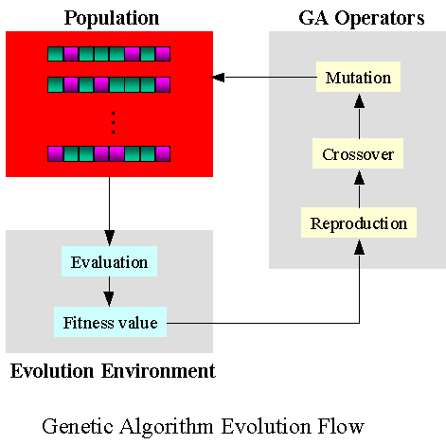

Slide 16
Basic GA Operators
Selection - Directing a GA search toward promising region in the search space.
Selection refers to choosing parents for recombination and new
population was formed by replacing parents with their offspring. They
called it as reproductive plan
Crossover - Looking for solutions near existing solutions
Mutation - Looking at completely new areas of search space

Slide 17
Fitness function
Quantifies the optimality of a solution (that is, a chromosome): that particular chromosome may be ranked against all the other chromosomes
A fitness value is assigned to each solution depending on how close it actually is to solving the problem.
Ideal fitness function correlates closely to goal + quickly computable.
For instance, for knapsack problem
Fitness Function = Total value of the things in the knapsack

Slide 18
So, how to select the best?
  Roulette Selection
  Rank Selection
  Steady State Selection
  Tournament Selection

Slide 19
Roulette wheel selection
Main idea:
the fitter is the solution with the most chances to be chosen
better individuals get higher chance
  Chances proportional to fitness
No. | String | Fitness | % Of Total
1 | 01101 | 169 | 14.4
2 | 11000 | 576 | 49.2
3 | 01000 | 64 | 5.5
4 | 10011 | 361 | 30.9
Total |  | 1170 | 100.0

Slide 20
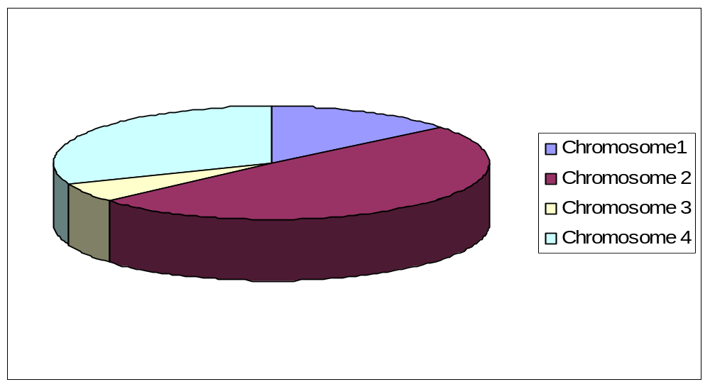
Roulette wheel selection
All you have to do is spin the ball and grab the chromosome at the
point it stops
Drawbacks??

Slide 21
Rank Selection
In rank-based fitness assignment, the population is sorted according to the objective values.
So individuals are ranked according to the fitness values
rank N is assigned to the best individual and the rank 1 to the worst individual if there are N individuals in the population
Then the individuals are selected with a probability that is linearly proportional to the rank of the individuals in the population.
Ranking introduces a uniform scaling across the population and provides a simple and effective way of controlling selective pressure.
Selective pressure is the degree to which the better individuals are favoured
Higher the selective pressure, the better individuals are favoured
Linear ranking allows values of selective pressure in [1.0, 2.0].

Slide 22
Tournament Selection
This strategy provides selective pressure by holding a tournament competition among N_{u} individuals
The best individual, i.e. the winner from the tournament is the one with highest fitness.
The winners are then inserted into the mating pool.
The whole process is repeated until the mating pool is filled.
Example??

Slide 23
Steady State Selection
This is not a particular method of selecting the parents
The main idea of selection is that bigger part of chromosomes should survive to the next generation
The offspring of the individuals selected from each generation go back into the pre-existing gene pool, replacing some of the less fit members of the previous generation. Some individuals are retained between generations.

Slide 24
Crossover
Main idea:
combine genetic material (bits) of 2 “parent” chromosomes ( solutions )
and produce a new “child” possessing characteristics of both “parents”.
For each consecutive pair apply crossover with probability P_{c} , otherwise copy parents. P_{c} typically in range (0.6, 0.9)
Crossover between 2 good solutions MAY NOT ALWAYS yield a better or as good a solution.
Since parents are good, probability of the child being good is high.
If offspring is not good (poor solution), it will be removed in the next iteration during “Selection”.

Slide 25
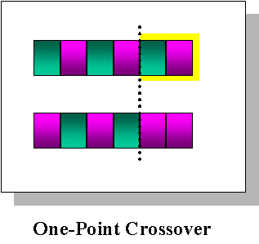
Crossover methods
Single Point Crossover- A random point is chosen on the individual chromosomes (strings) and the genetic material is exchanged at this point.

Slide 26
Crossover methods
Two-Point Crossover- Two random points are chosen on the individual chromosomes (strings) and the genetic material is exchanged at these points.
Chromosome1 | 11011 | 00100 | 110110
Chromosome 2 | 10101 | 11000 | 011110
Offspring 1 | 10101 | 00100 | 011110
Offspring 2 | 11011 | 11000 | 110110

Slide 27
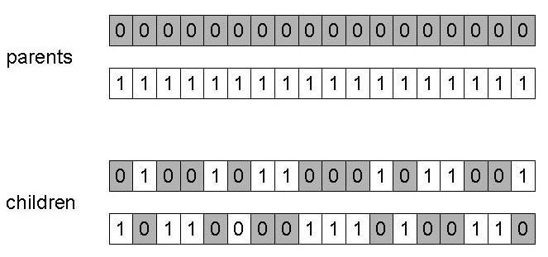
Crossover methods
Uniform crossover –
Assign 'heads' to one parent, 'tails' to the other
Flip a coin for each gene of the first child
Make an inverse copy of the gene for the second child
Inheritance is independent of position
Sometimes gene in the offspring is created by copying the corresponding gene from one or the other parent chosen according to a randomly generated mask.

Slide 28
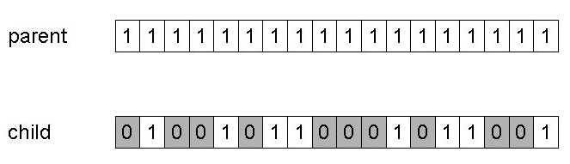
Mutation
Alter each gene independently with a probability p_{m}
p_{m} is called the mutation rate
  Typically between 1/pop_size and 1/ chromosome_length

Slide 29
Crossover OR mutation?
There is co-operation AND competition between them
Crossover is explorative, it makes a big jump to an area somewhere “in between” two (parent) areas
Mutation is exploitative, it creates random small diversions, thereby staying near (in the area of ) the parent
Exploration: Discovering promising areas in the search space, i.e. gaining information on the problem
Exploitation: Optimising within a promising area, i.e. using information
To hit the optimum it’s often needed a ‘lucky’ mutation

Slide 30
Elitism
  In Holland's original GA, parents are replaced by their offspring soon
  after they give birth.
    This is called as generational replacement.
  Because genetic operations are blind in nature, offspring may be worse than their parents.
    To overcome this problem, several replacement strategies have been examined.
  Holland suggested that each offspring replaces a randomly chosen chromosome of the current population as it was born.
  De Jong proposed a crowding strategy
    In the crowding model, when an offspring was born, one parent was selected to die. The dying parent was chosen as that parent that was most closely resembled the new offspring using a simple bit-by-bit similarity count to measure resemblance.

Slide 31
Example
Simple problem: max x² over {0,1,…,31}
GA approach:
  Representation: binary code, e.g. 01101 ↔ 13
  Population size: 4
  1-point crossover, bitwise mutation
  Roulette wheel selection
  Random initialization

Slide 32
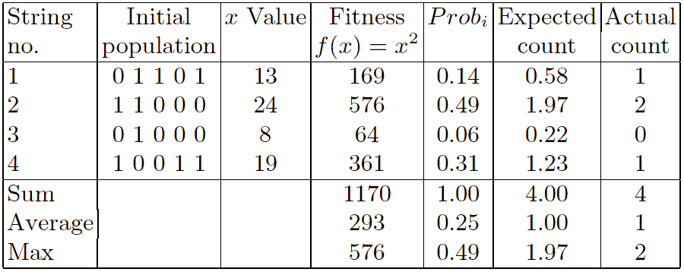
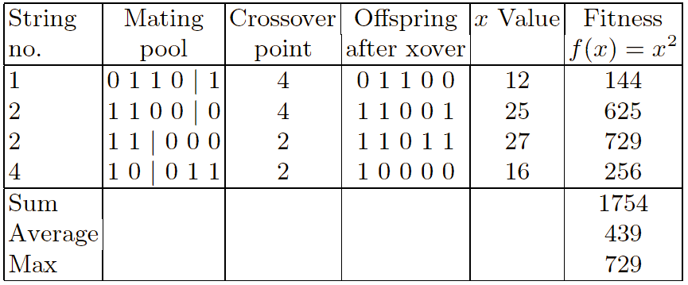
Example: Selection & Crossover

Slide 33
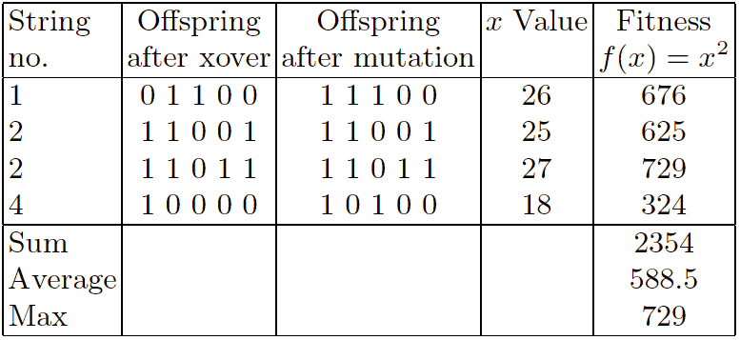
Example: Mutation

Slide 34
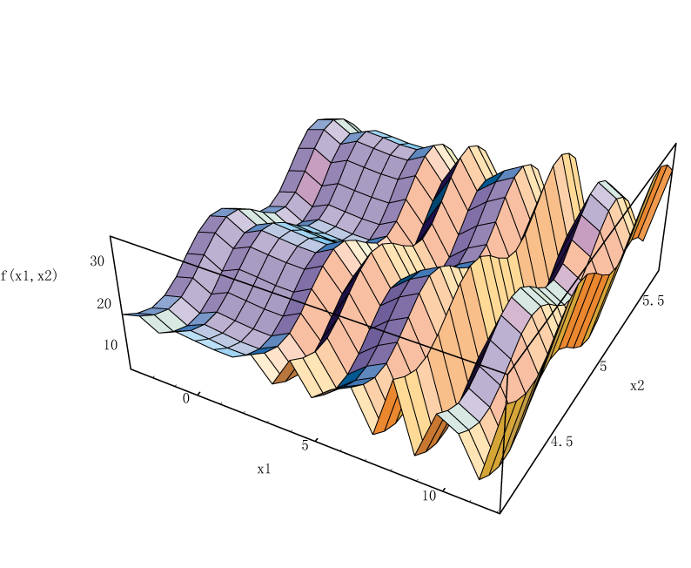
Another Example
max f (x1, x2) = 21.5 + x1·sin(4 Π x1) + x2·sin(20 Π x2)
s. t. -3.0 ≤ x1 ≤ 12.1
4.1 ≤ x2 ≤ 5.8

Slide 35
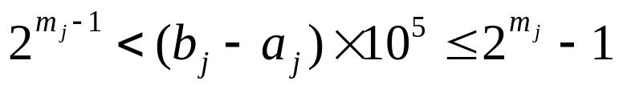
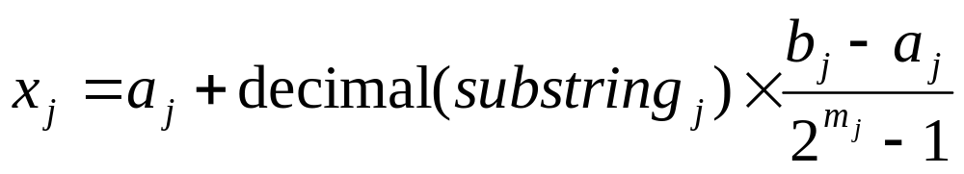
Representation
Binary String Representation
The domain of x_{j} is [a_{j}, b_{j}] and the required precision is five places after the decimal point.
The precision requirement implies that the range of domain of each variable should be divided into at least (b_{j} - a_{j} )×10⁵ size ranges.
The required bits (denoted with m_{j}) for a variable is calculated as follows:
The mapping from a binary string to a real number for variable x_{j} is completed as follows:

Slide 36
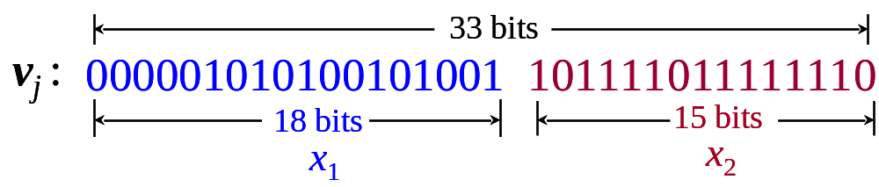
Representation
The precision requirement implies that the range of domain of each variable should be divided into at least (b_{j} - a_{j} )×10⁵ size ranges.
The required bits (denoted with m_{j}) for a variable is calculated as follows:
x₁ : (12.1-(-3.0)) × 10,000 = 151,000
2¹⁷ <151,000 ≤ 2¹⁸, m₁ = 18 bits
x₂ : (5.8-4.1) × 10,000 = 17,000
2¹⁴ <17,000 ≤ 2¹⁵, m₂ = 15 bits
precision requirement: m = m₁ + m₂ = 18 +15 = 33 bits

Slide 37
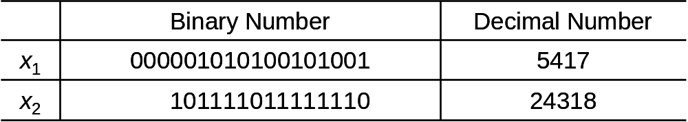
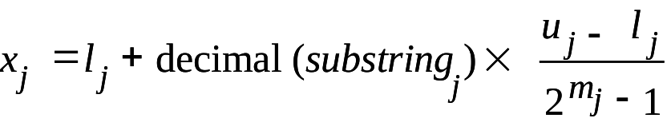
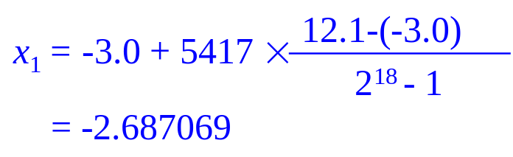
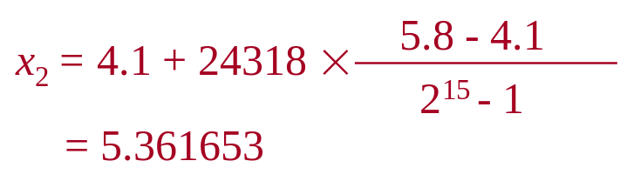
Representation
The mapping from a binary string to a real number for variable
x_{j} is completed as follows:

Slide 38
Initial Population
Initial population is randomly generated as follows:
v₁ = [000001010100101001101111011111110] = [x₁ x₂] = [-2.687969 5.361653]
v₂ = [001110101110011000000010101001000] = [x₁ x₂] = [ 0.474101 4.170144]
v₃ = [111000111000001000010101001000110] = [x₁ x₂] = [10.419457 4.661461]
v₄ = [100110110100101101000000010111001] = [x₁ x₂] = [ 6.159951 4.109598]
v₅ = [000010111101100010001110001101000] = [x₁ x₂] = [ -2.301286 4.477282]
v₆ = [111110101011011000000010110011001] = [x₁ x₂] = [11.788084 4.174346]
v₇ = [110100010011111000100110011101101] = [x₁ x₂] = [ 9.342067 5.121702]
v₈ = [001011010100001100010110011001100] = [x₁ x₂] = [ -0.330256 4.694977]
v₉ = [111110001011101100011101000111101] = [x₁ x₂] = [11.671267 4.873501]
v₁₀ = [111101001110101010000010101101010] = [x₁ x₂] = [11.446273 4.171908]

Slide 39
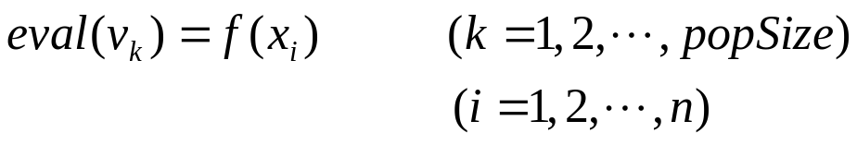
Evaluation
The process of evaluating the fitness of a chromosome consists of the following three steps:
procedure: Evaluation
step 1: Convert the chromosome’s genotype to its phenotype, i.e., convert binary string into relative real values x_{k} =(x_{k1}, x_{k2}), k = 1,2, …, popSize.
step 2: Evaluate the objective function f (x_{k}), k = 1,2, …, popSize.
step 3: Convert the value of objective function into fitness. For the maximization problem, the fitness is simply equal to the value of objective function:
eval(v_{k}) = f (x_{k}), k = 1,2, …, popSize.
f (x₁, x₂) = 21.5 + x₁·sin(4π x₁) + x2·sin(20π x₂)
eval(v₁) = f (-2.687969, 5.361653) =19.805119

Slide 40
Evaluation
An evaluation function plays the role of the environment,
and it rates chromosomes in terms of their fitness.
The fitness function values of above chromosomes are as follows:
It is clear that chromosome v₄ is the strongest one and that chromosome v₃ is the weakest one.
eval(v₁) = f (-2.687969, 5.361653) =19.805119
eval(v₂) = f (0.474101, 4.170144) = 17.370896
eval(v₃) = f (10.419457, 4.661461) = 9.590546
eval(v₄) = f (6.159951, 4.109598) = 29.406122
eval(v₅) = f (-2.301286, 4.477282) = 15.686091
eval(v₆) = f (11.788084, 4.174346) = 11.900541
eval(v₇) = f (9.342067, 5.121702) = 17.958717
eval(v₈) = f (-0.330256, 4.694977) = 19.763190
eval(v₉) = f (11.671267, 4.873501) = 26.401669
eval(v₁₀) = f (11.446273, 4.171908) = 10.252480

Slide 41
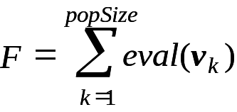
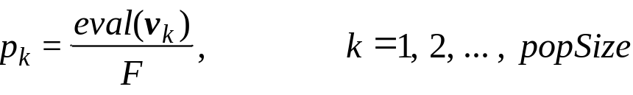
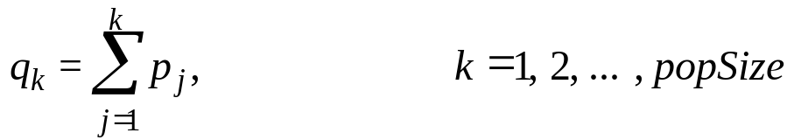
Genetic Operators
Selection:
  In most practices, a roulette wheel approach is adopted as the selection procedure, which is one of the fitness-proportional selection and can select a new population with respect to the probability distribution based on fitness values.
  The roulette wheel can be constructed with the following steps:
step 1: Calculate the total fitness for the population
step 2: Calculate selection probability p_{k} for each chromosome v_{k}
step 3: Calculate cumulative probability q_{k} for each chromosome v_{k}
step 4: Generate a random number r from the range [0, 1].
step 5: If r ≤ q₁, then select the first chromosome v₁; otherwise, select the kth chromosome v_{k} (2 ≤ k ≤ popSize) such that q_{k-1}< r ≤ q_{k} .

Slide 42
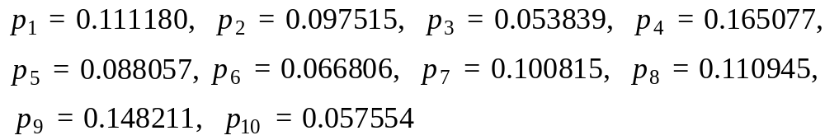
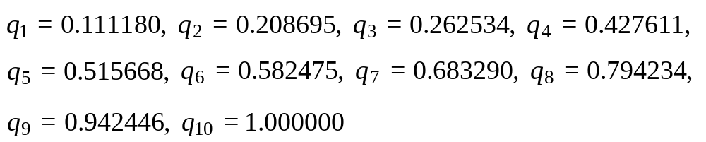
Genetic Operators
Illustration of Selection:
step 1: Calculate the total fitness F for the population.
10
=
∑
=
F
eval
(
v
k
)
178
.
135372
k
=
1
step 2: Calculate selection probability p_{k} for each chromosome v_{k}.
step 3: Calculate cumulative probability q_{k} for each chromosome v_{k}.
step 4: Generate a random number r from the range [0, 1].
0.301431,
0.322062,
0.766503,
0.881893,
0.350871,
0.583392,
0.177618,
0.343242,
0.032685,
0.197577

Slide 43
Genetic Operators
Illustration of Selection:
step 5: q₃< r₁ = 0.301432 ≤ q₄, it means that the chromosome v₄ is selected
for new population; q₃< r₂ = 0.322062 ≤ q₄, it means that the chromosome
v₄ is selected again, and so on. Finally, the new population consists of the
following chromosome.
v'₁ = [100110110100101101000000010111001] (v₄ )
v'₂ = [100110110100101101000000010111001] (v₄ )
v'₃ = [001011010100001100010110011001100] (v₈ )
v'₄ = [111110001011101100011101000111101] (v₉ )
v'₅ = [100110110100101101000000010111001] (v₄ )
v'₆ = [110100010011111000100110011101101] (v₇ )
v'₇ = [001110101110011000000010101001000] (v₂ )
v'₈ = [100110110100101101000000010111001] (v₄ )
v'₉ = [000001010100101001101111011111110] (v₁ )
v'₁₀ = [001110101110011000000010101001000] (v₂ )

Slide 44
Genetic Operators
Crossover (One-cut point crossover)
  Crossover used here is one cut point method, which random selects one cut point.
  Exchanges the right parts of two parents to generate offspring.
  Consider two chromosomes as follow and the cut point is randomly selected after the 17th gene:
crossing point at 17th gene
v₁ = [100110110100101101000000010111001]
v₂ = [001110101110011000000010101001000]
c₁ = [100110110100101100000010101001000]
c₂ = [001110101110011001000000010111001]

Slide 45
Genetic Operators
Mutation
  Alters one or more genes with a probability equal to the mutation rate.
  Assume that the 16th gene of the chromosome v₁ is selected for a mutation.
  Since the gene is 1, it would be flipped into 0. So the chromosome after mutation would be:
mutating point at 16th gene
v₁ = [100110110100101101000000010111001]
c₁ = [100110110100101000000010101001000]

Slide 46
Next Generation
v₁' = [100110110100101101000000010111001], f (6.159951, 4.109598) = 29.406122
v₂' = [100110110100101101000000010111001], f (6.159951, 4.109598) = 29.406122
v₃' = [001011010100001100010110011001100], f (-0.330256, 4.694977) = 19.763190
v₄' = [111110001011101100011101000111101], f (11.907206, 4.873501) = 5.702781
v₅' = [100110110100101101000000010111001], f (8.024130, 4.170248) = 19.91025
v₆' = [110100010011111000100110011101101], f (9.34067, 5.121702) = 17.958717
v₇' = [100110110100101101000000010111001], f (6.159951, 4.109598) = 29.406122
v₈' = [100110110100101101000000010111001], f (6.159951, 4.109598) = 29.406122
v₉' = [000001010100101001101111011111110], f (-2.687969, 5.361653) = 19.805199
v₁₀' = [001110101110011000000010101001000], f (0.474101, 4.170248) = 17.370896

Slide 47
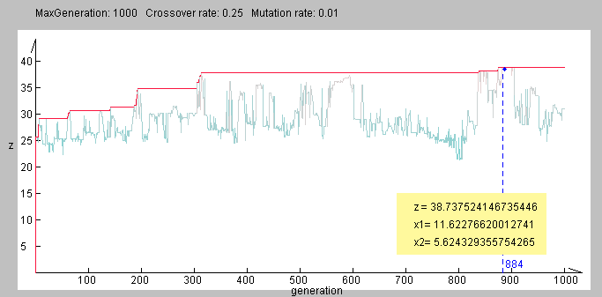
Final Result
Evolutional Process
maxGen: 1000 p_{C}: 0.25 p_{M}: 0.01

Slide 48

GENETIC PROGRAMMING
Notes:
BBB4003

Slide 49
THE CHALLENGE
"How can computers learn to solve problems without being explicitly programmed? In other words, how can computers be made to do what is needed to be done, without being told exactly how to do it?"
⎯ Attributed to Arthur Samuel (1959)

Slide 50
CRITERION FOR SUCCESS
"The aim is ... to get machines to exhibit behavior, which if done by humans, would be assumed to involve the use of intelligence.“
⎯ Arthur Samuel (1983)

Slide 51
What is Genetic Programming?
A method to evolve computer programs
Automatic programming: Solve problems without explicitly being programmed
Works by using Genetic Algorithms to automatically generate computer programs

Slide 52
What is Genetic Programming?
Part of larger discipline called Machine Learning. Machine learning can be best described as "the study of computer algorithms that improve automatically through experience" (Mitchell 1996).
It attempts to solve the problem - How can computers be made to do what needs to be done without being told exactly how to do it?
This is where the aspect of Artificial Intelligence comes into play.

Slide 53
Why Genetic Programming?
It saves time by freeing the human from having to design complex algorithms. Not only designing the algorithms but creating ones that give optimal solutions.
“It combines genetic algorithms with the basic thrust of AI, which was to get computers to do things automatically – to evolve a population of programs” - John R. Koza

Slide 54
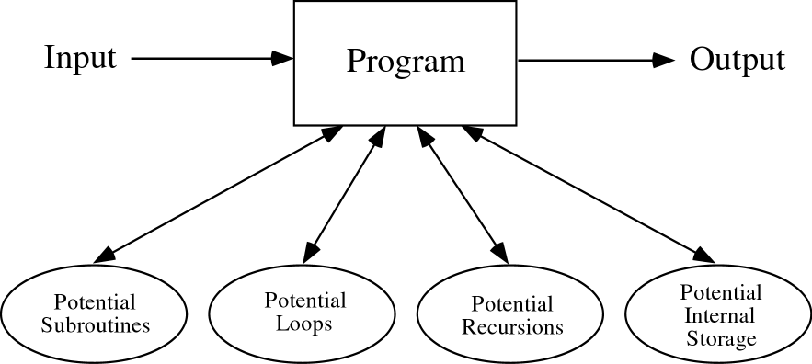
A COMPUTER PROGRAM
Notes:
BBB121

Slide 55
GENETIC PROGRAMMING (GP)
GP applies the approach of the genetic algorithm to the space of possible computer programs
Computer programs are the lingua franca for expressing the solutions to a wide variety of problems
A wide variety of seemingly different problems from many different fields can be reformulated as a search for a computer program to solve the problem.

Slide 56
GP ⎯ MAIN POINTS
Genetic programming now routinely delivers high-return human-competitive machine intelligence.
Genetic programming is an automated invention machine.

Slide 57
DEFINITION OF “HIGH-RETURN”
The AI ratio (the “artificial-to-intelligence” ratio) of a problem-solving method as the ratio of that which is delivered by the automated operation of the artificial method to the amount of intelligence that is supplied by the human applying the method to a particular problem

Slide 58
DEFINITION OF “ROUTINE”
A problem solving method is routine if it is general and relatively little human effort is required to get the method to successfully handle new problems within a particular domain and to successfully handle new problems from a different domain.

Slide 59
CRITERIA FOR
“HUMAN-COMPETITIVENESS”
Previously patented, an improvement over a patented invention, or patentable today
Publishable in its own right as a new scientific result ⎯ independent of the fact that the result was mechanically created
Holds it own in regulated competition against humans (or programs)
5 other similar criteria that are “arms-length” from the fields of AI, ML, GP

Slide 60
PROGRESSION OF QUALITATIVELY MORE SUBSTANTIAL RESULTS PRODUCED BY GP
Toy problems
Human-competitive non-patent results
20th-century patented inventions
21st-century patented inventions
Patentable new inventions

Slide 61
Algorithm
Randomly create an initial population of programs from the available primitives
Repeat
Execute each program and ascertain its fitness
Select one or two program(s) from the population with a probability based on fitness to participate in genetic operations
Create new individual program(s) by applying genetic operations with specified probabilities
until an acceptable solution is found or some other stopping condition is met
return the best-so-far individual

Slide 62
Data Representation
Programs can be considered as strings
Limitation: It’s mostly inappropriate to assume a fixed length of programs
It’s necessary to modify the data representation
The common approach to represent programs in GP is to consider programs as trees.

Slide 63
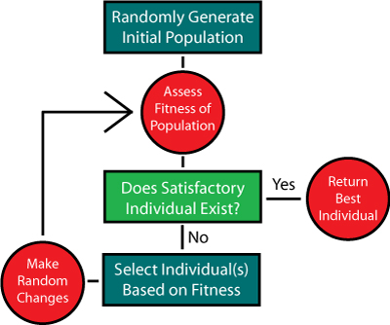
FLOWCHART OF GENETIC PROGRAMMING

Slide 64
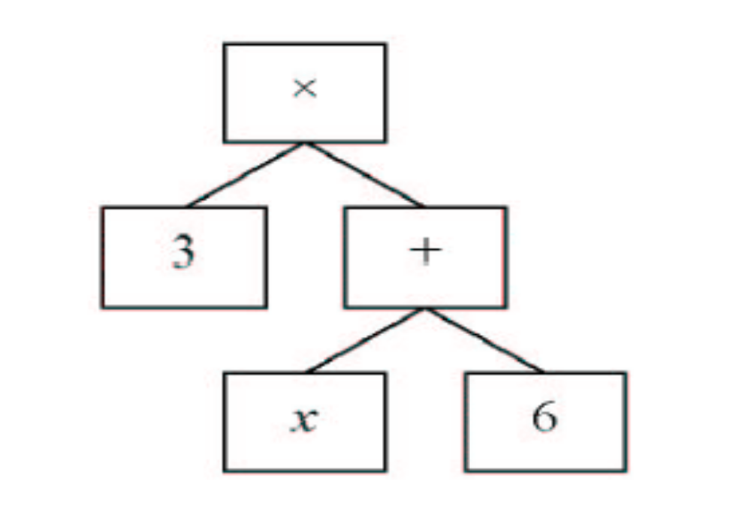
A Simple Example of an Individual that returns 3(x+6)

Slide 65
A COMPUTER PROGRAM IN C
int foo (int time)
{
int temp1, temp2;
if (time > 10)
temp1 = 3;
else
temp1 = 4;
temp2 = temp1 + 1 + 2;
return (temp2);
}

Slide 66
OUTPUT OF C PROGRAM
Time | Output
0 | 6
1 | 6
2 | 6
3 | 6
4 | 6
5 | 6
6 | 6
7 | 6
8 | 6
9 | 6
10 | 6
11 | 7
12 | 7

Slide 67
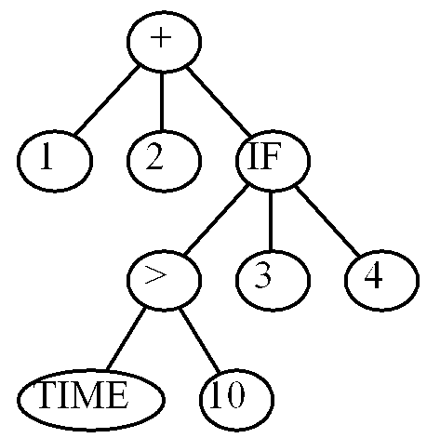
PROGRAM TREE
(+ 1 2 (IF (> TIME 10) 3 4))

Slide 68
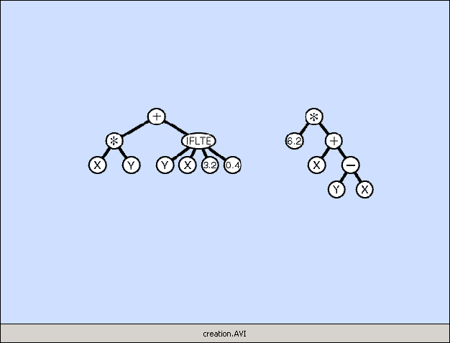
CREATING RANDOM PROGRAMS
Notes:
Creation.avi (creation.gif converted to AVI movie file)

Slide 69
Basics
Terminal: The variables and constants in the program (x, y and 3) which forms leaves of the tree.
Funtion: The arithmetic operations (+, * and max) are internal nodes called functions.
Primitive set : Functions and terminals together from primitive set.

Slide 70
Initialization of population
Full Method: Selecting internal nodes from function set untill maximum depth is reached. At the end, select node from terminal set. All leaves are at same level.
Grow Method: Select nodes from the primitive set until maximum depth is reached.
Ramped half-and-half: Half the initial population is constructed using full and half is constructed using grow. Depth limits of trees not fixed.

Slide 71

GROW

Slide 72

FULL

Slide 73
Initialization of population(Contd.)‏
Initialization need not be entirely random.
If properties of the desired solution is known, produce trees accordingly. This creates intial bias in population for faster convergence.

Slide 74
CREATING RANDOM PROGRAMS
Available functions F = {+, -, *, %, IFLTE}
Available terminals T = {X, Y, Random-Constants}
The random programs are:
  Of different sizes and shapes
  Syntactically valid
  Executable

Slide 75
GP GENETIC OPERATIONS
Reproduction
Mutation
Crossover (sexual recombination)
Architecture-altering operations

Slide 76
REPRODUCTION OPERATION
Select parent probabilistically based on fitness
Copy it (unchanged) into the next generation of the population

Slide 77
Selection Strategies
Tournament Selection: Best individual from a set of randomly selected individuals is chosen to be parent.
Advantage: It rescales fitness among the population. A best program doesn't populate the next generation with its children reducing diversity.
Disadvantage: A small difference in fitness gets amplified in next generation. Even though it is just marginally better than its competitior.

Slide 78
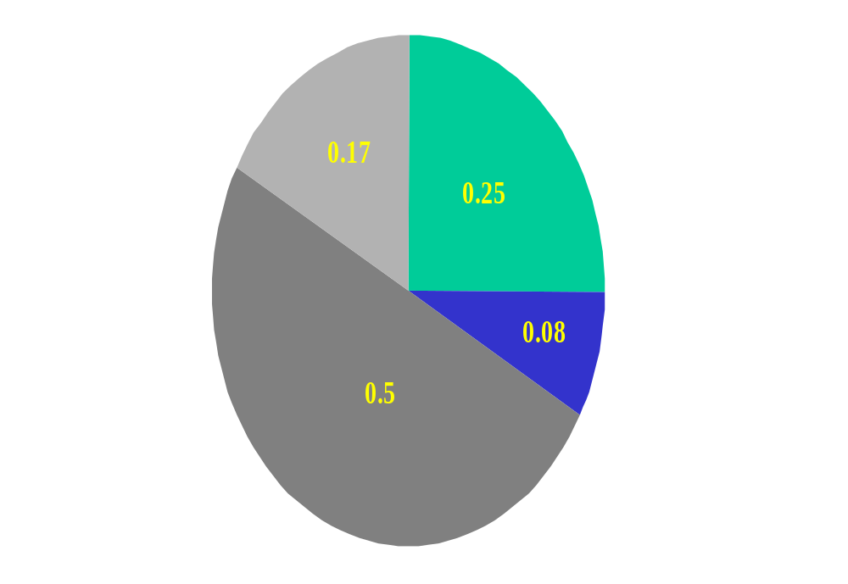
Selection Strategies(Contd.)‏
Fitness-Proportionate Selection: Select individuals based on their fitness values.

Slide 79
Breeding Next Generation
Crossover, mutation and reproduction are main operators applied on parents to generate offsprings.
Subtree Crossover: Create the offspring by replacing the subtree rooted at the crossover point in a copy of the first parent with a copy of the subtree rooted at the crossover point in the second parent.
Reproduction: Simply copy an elite individual to next generation. Ensures passing of good genes.

Slide 80
CROSSOVER OPERATION
Select 2 parents probabilistically based on fitness
Randomly pick a number from 1 to NUMBER-OF-POINTS for 1st parent
Independently randomly pick a number for 2nd parent
The result is a syntactically valid executable program
Put the offspring into the next generation of the population
Identify the subtrees rooted at the two picked points

Slide 81
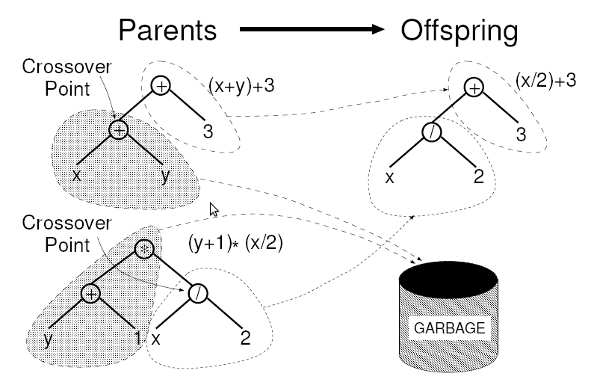
Subtree Crossover

Slide 82
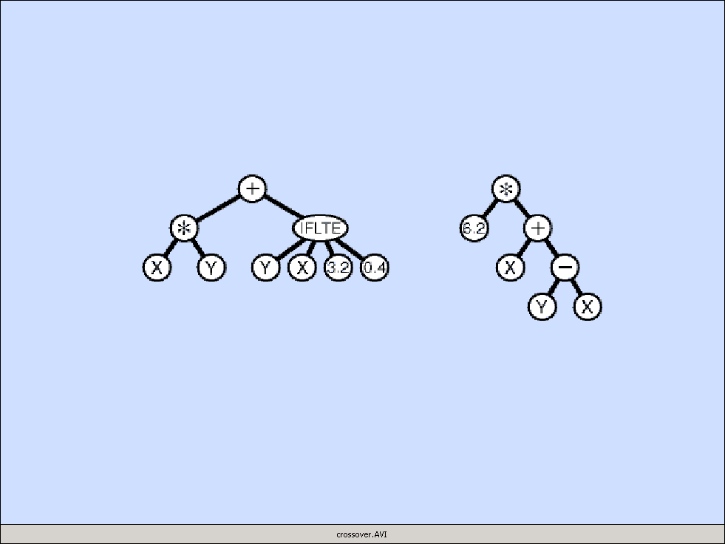
CROSSOVER OPERATION
Notes:
Crossover.avi

Slide 83
MUTATION OPERATION
Select 1 parent probabilistically based on fitness
Pick point from 1 to NUMBER-OF-POINTS
Delete subtree at the picked point
Grow new subtree at the mutation point in same way as generated trees for initial random population (generation 0)
The result is a syntactically valid executable program
Put the offspring into the next generation of the population

Slide 84

MUTATION OPERATION
Notes:
Mutation.avi

Slide 85
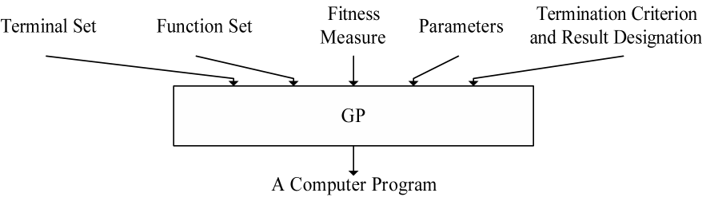
FIVE MAJOR PREPARATORY STEPS FOR GP
Determining the set of terminals
Determining the set of functions
Determining the fitness measure
Determining the parameters for the run
Determining the method for designating a result and the criterion for terminating a run
Notes:
BBB3666 (converted to BMP from eps)
The following were cut as parameter subpoints so that the text fit on a slide
population size
number of generations
minor parameters

Slide 86
ILLUSTRATIVE GP RUN

Slide 87
SYMBOLIC REGRESSION
Independent variable X | Dependent variable Y
-1.00 | 1.00
-0.80 | 0.84
-0.60 | 0.76
-0.40 | 0.76
-0.20 | 0.84
0.00 | 1.00
0.20 | 1.24
0.40 | 1.56
0.60 | 1.96
0.80 | 2.44
1.00 | 3.00

Slide 88
PREPARATORY STEPS
 | Objective: | Find a computer program with one input (independent variable X) whose output equals the given data
1 | Terminal set: | T = {X, Random-Constants}
2 | Function set: | F = {+, -, *, %}
3 | Fitness: | The sum of the absolute value of the differences between the candidate program’s output and the given data (computed over numerous values of the independent variable x from –1.0 to +1.0)
4 | Parameters: | Population size M = 4
5 | Termination: | An individual emerges whose sum of absolute errors is less than 0.1

Slide 89
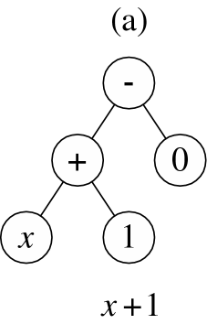
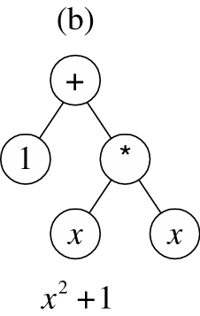
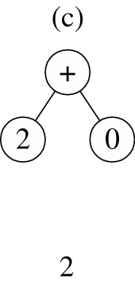
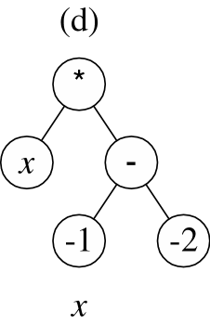
SYMBOLIC REGRESSION
POPULATION OF 4 RANDOMLY CREATED INDIVIDUALS FOR GENERATION 0
Notes:
BBB3663 was broken into 4 components and converted to BMP files for the incremental unveiling

Slide 90
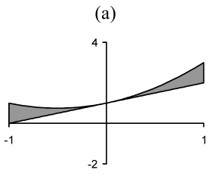
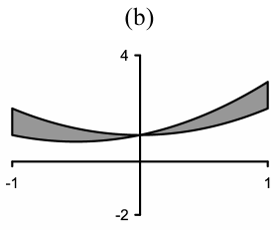
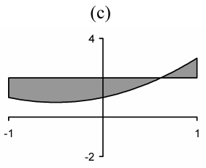
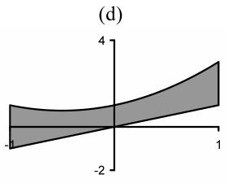
SYMBOLIC REGRESSION x² + x + 1
FITNESS OF THE 4 INDIVIDUALS IN GEN 0
x + 1
x² + 1
2
x
0.67
1.00
1.70
2.67
Notes:
BBB3662 was broken up into 4 indidual BMP files from the original eps file to satisfy display constraings

Slide 91
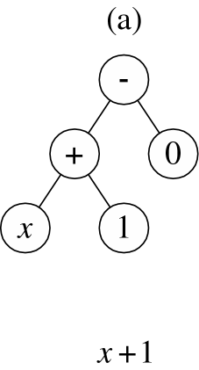
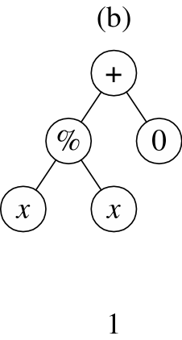
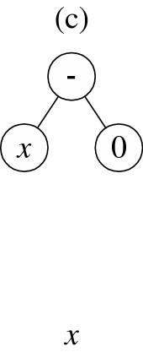
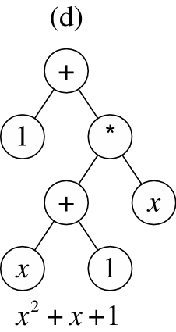
SYMBOLIC REGRESSION x² + x + 1
GENERATION 1
Second offspring of crossover of (a) and (b)
picking “+” of parent (a) and left-most “x” of parent (b) as crossover points
First offspring of crossover of (a) and (b)
picking “+” of parent (a) and left-most “x” of parent (b) as crossover points
Mutant of (c)
picking “2” as mutation point
Copy of (a)
Notes:
BBB3664 was broken up into 4 indidual BMP files from the original eps file to satisfy display constraings

Slide 92
GP quick overview
Developed: USA in the 1990’s
Early names: J. Koza
Typically applied to:
  machine learning tasks (prediction, classification…)
Attributed features:
  competes with neural nets and alike
  needs huge populations (thousands)
  slow
Special:
  non-linear chromosomes: trees, graphs
  mutation possible but not necessary (disputed!)

Slide 93
GP technical summary tableau
Representation | Tree structures
Recombination | Exchange of subtrees
Mutation | Random change in trees
Parent selection | Fitness proportional
Survivor selection | Generational replacement

Slide 94
Introductory example: credit scoring
A possible model:
IF (NOC = 2) AND (S > 80000) THEN good ELSE bad
In general:
IF formula THEN good ELSE bad
Only unknown is the right formula, hence
Our search space (phenotypes) is the set of formulas
Natural fitness of a formula: percentage of well classified cases of the model it stands for
Natural representation of formulas (genotypes) is: parse trees

Slide 95
Introductory example: credit scoring
IF (NOC = 2) AND (S > 80000) THEN good ELSE bad
can be represented by the following tree
AND
=
>
NOC
2
S
80000

Slide 96
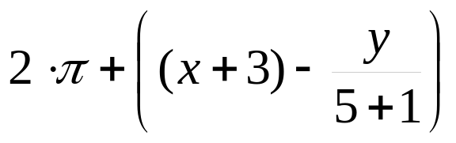
Tree based representation
Trees are a universal form, e.g. consider
Arithmetic formula
Logical formula
Program
(x ∧ true) → (( x ∨ y ) ∨ (z ↔ (x ∧ y)))
i =1;
while (i < 20)
{
i = i +1
}

Slide 97
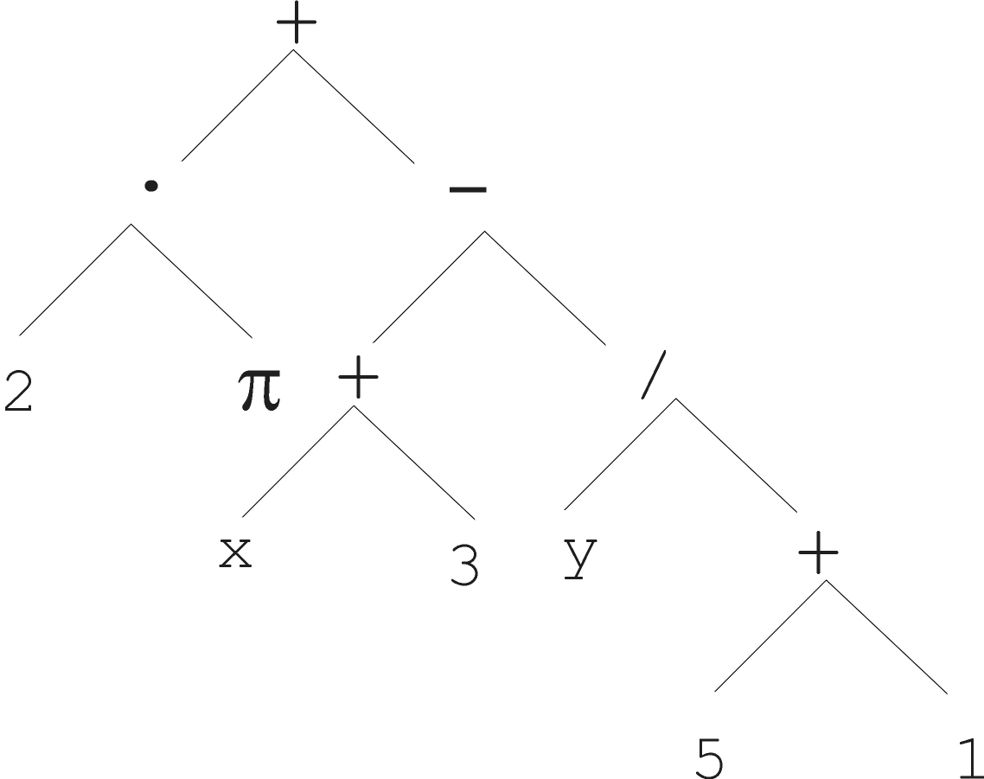
Tree based representation

Slide 98
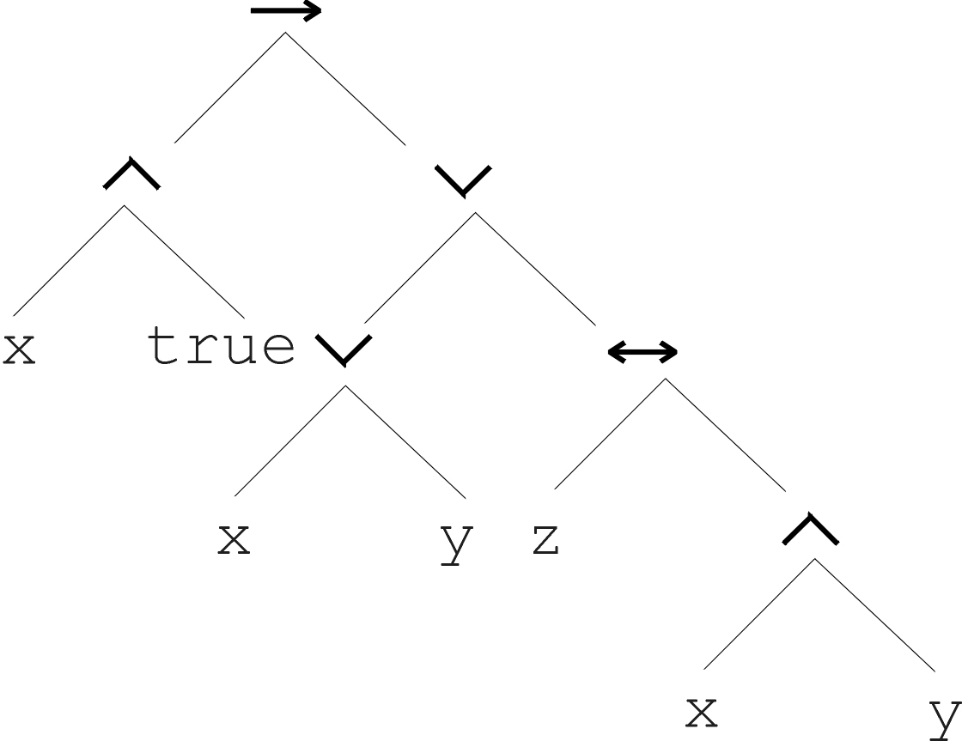
Tree based representation
(x ∧ true) → (( x ∨ y ) ∨ (z ↔ (x ∧ y)))

Slide 99
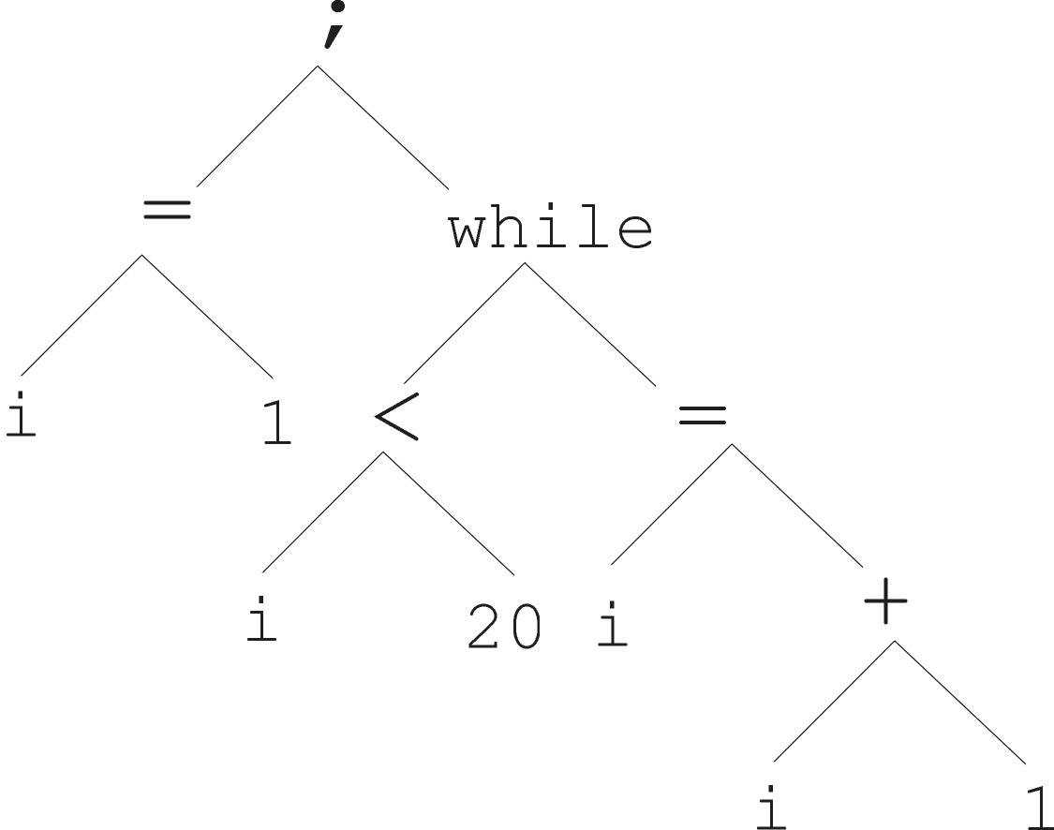
Tree based representation
i =1;
while (i < 20)
{
i = i +1
}

Slide 100
Tree based representation
In GA, ES, EP chromosomes are linear structures (bit strings, integer string, real-valued vectors, permutations)
Tree shaped chromosomes are non-linear structures
In GA, ES, EP the size of the chromosomes is fixed
Trees in GP may vary in depth and width

Slide 101
Offspring creation scheme
Compare
GA scheme using crossover AND mutation sequentially (be it probabilistically)
GP scheme using crossover OR mutation (chosen probabilistically)

Slide 102


GA flowchart
GP flowchart

Slide 103


Mutation
Most common mutation: replace randomly chosen subtree by randomly generated tree

Slide 104
Recombination
Most common recombination: exchange two randomly chosen subtrees among the parents
Recombination has two parameters:
  Probability p_{c} to choose recombination vs. mutation
  Probability to chose an internal point within each parent as crossover point
The size of offspring can exceed that of the parents

Slide 105




Parent 1
Parent 2
Child 1
Child 2

